Slide 1
STROKE PREDICTION
Data Analysis and Models
Shehzad Ali
Rohitashwa Chakraborty
Soumik Choudhuri
Casey Copeland
Divyansh Karki
Notes:
Shehzad: Attention grabber, introduce what we will be talking about, and introduce team members.

Slide 2
Problem Statement
Can human variables be predictive of strokes? How can individuals, hospitals, and public health officials use this analysis to predict and prevent stroke occurrences.
Notes:
Shehzad:Problem Statement: What are the important factors in predicting strokes and how can hospitals/public health use this information to prevent strokes and help identify
High risk people and let them know what to do if they experience a stroke.
Our data
Our models
What factors make strokes more likely
Our recommendations for hospitals and public health officials
Template/handout for public health officials w/ key findings from the data
https://www.stroke.org/en/about-stroke

Slide 3
TABLE OF CONTENTS
01
INITIAL FINDINGS
02
PREDICTIVE
MODELING
03
CONCLUSION
Notes:
Shehzad: In this presentation my colleagues will talk about their initial findings from the data, the models they ran and the subsequent results, and we will conclude with drawbacks and the application of the model.

Slide 4
01
INITIAL
FINDINGS
Notes:
Our dataset
Model testing:
Tree based models are preferable due to the amount of categorical variable

Slide 5
DATASET VARIABLES
NUMERICAL
CATEGORICAL
Age
Average glucose level
Body mass index
Gender
Hypertension
Heart disease
Marital status/history
Work type
Urban vs Rural
Smoking history
Notes:
Because variables were more categorical we decided to go with trees instead of KNN

Slide 6
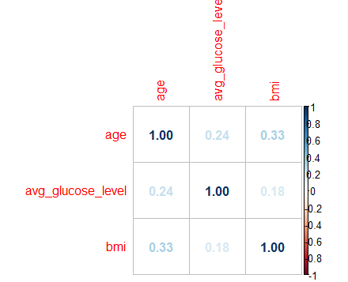
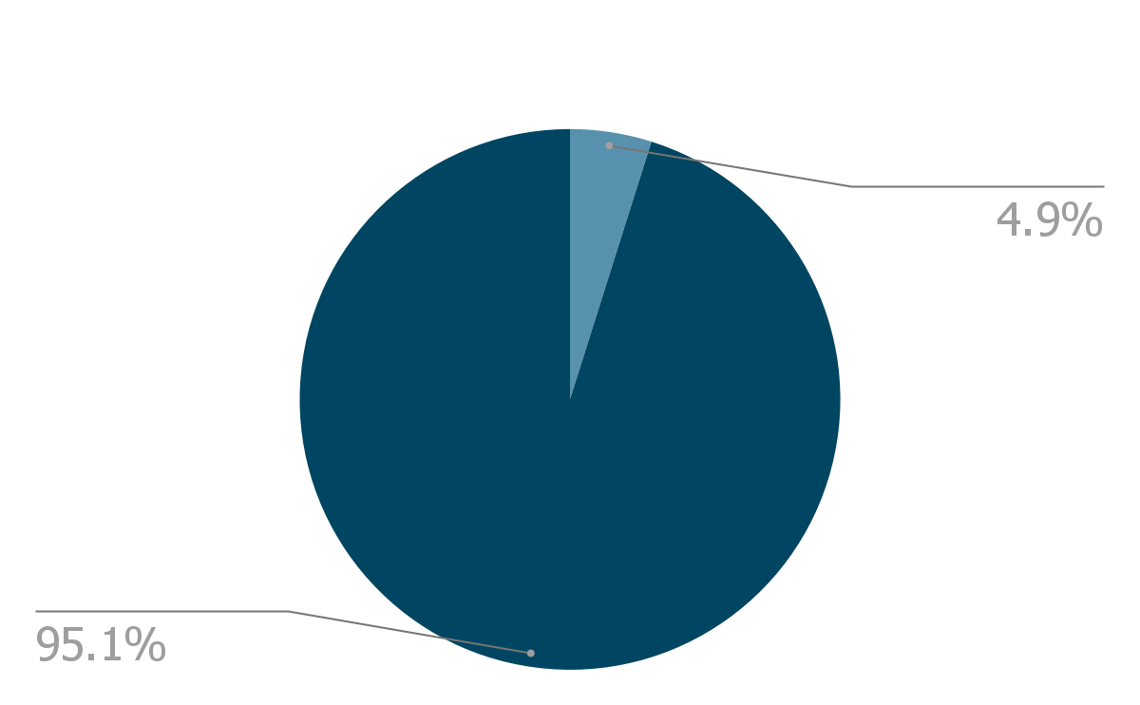
OUR DATA SET
Stroke | 249
No Stroke | 4861
Total | 5110
Notes:
SAY: 5000 total observations, since it was a small dataset we had issues with skewed classes and this impacted how we ran our model
THOUGHTS BEHIND IT:
Sample = roughly observations, 4861 no stroke, 249 stroke’ yes’ binary observations
`- decided to oversample the under-represented class to train and validate
`- Ran boosting with all variables - got important variables and understood the issue with the class size (poor performance in validation)
`- decided to oversample the under-represented class to train and validate
Prioritize recall over precision to lessen likelihood of false negatives
6% of the people in our data suffered a stroke
What is the ideal threshold when measuring probability of a stroke?
Do we need to oversample the data?

Slide 7
02
PREDICTIVE MODELING
Notes:
MODELS TRIED & WHAT WE CHOSE:
KNN - Qualitative, was a no (b/c most predictors were categorical. And could not calc. distances between cat. params)
RANDOM FOREST
BAGGING
BOOSTING & THRESHOLD

Slide 8
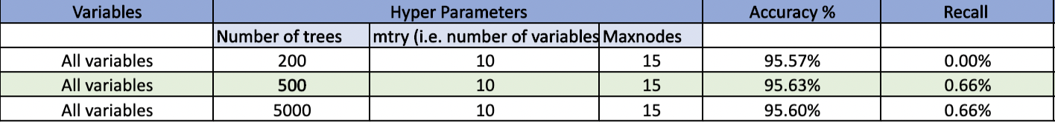
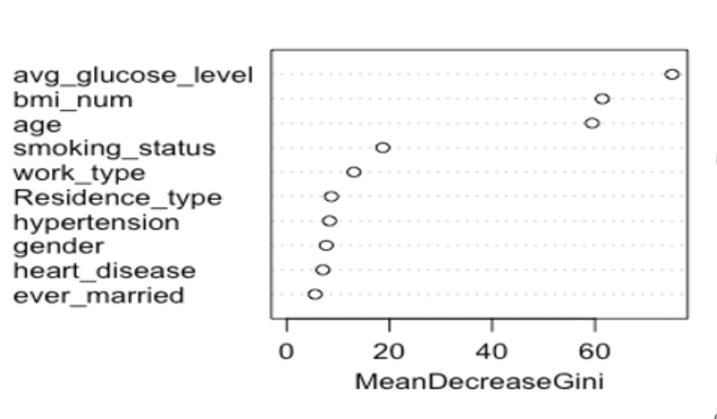
BAGGING
Bagging - All Variables
Results:
Notes:
in tree based approach, we started with the bagging technique.
initially, we included all the variables present in the model and ran a few iterations changing the number of trees, but fixed the maxnodes at 15 so that the trees are not too complex.
500 was the optimum number of trees with a 95 prrcent accuracy, but the recall was pretty low.
the reason we are concerned with recall is because that actually shows how many true strokes we are able to predict beforehand and save lives.
From the var importance chart, we took the top 3 important variables which were in turn the only numeric variables present in the model and proceeded with those.

Slide 9
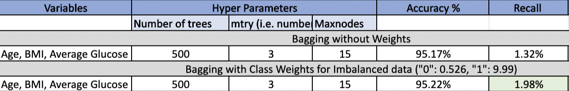

BAGGING
Bagging - 3 Variables
Class Weights
(No Stroke)
(Stroke)
Notes:
now, with the top 3 vars, we obtained a slightly better recall keeping the number of trees as 500.
then, in order to improve the class imbalance present in the dataset, we assigned class weights to the 2 categories.
we assigned a much higher class weight to the Strokes as compared to non-strokes and then again ram the bagging technique. this time, we saw more improvement in the recall percent, but it was not significant enough to say that we have a good model. So we moved on to boosting techniques and Divyansh will now discuss about how boosting has helped us.

Slide 10
BOOSTING
Variables | Precision | Recall
# of trees: 2000 ; shrinkage : 0.1 ; depth : 4 | 25% | 11%
# of trees: 2000 ; shrinkage : 0.1 ; depth : 10 | 15% | 5%
# of trees: 2000 ; shrinkage : 0.001 ; depth : 4 | NA | 0%
# of trees: 2000 ; shrinkage : 0.001 ; depth : 10 | NA | 0%
# of trees: 5000 ; shrinkage : 0.1 ; depth : 4 | 19% | 8%
# of trees: 5000 ; shrinkage : 0.1 ; depth : 10 | 20% | 8%
# of trees: 5000 ; shrinkage : 0.001 ; depth : 4 | 100% | 5%
# of trees: 5000 ; shrinkage : 0.001 ; depth : 10 | 67% | 5%
Test Set
 | Actual
Predicted | 0 | 1
0 | 722 | 29
1 | 13 | 3
Accuracy Measures
Accuracy | 94.52%
Precision | 18.75%
Recall | 9.38%
Probability threshold
If P(stroke | all variables) is greater than .5 then we predicted stroke, else no stroke.
Notes:
Split into train, validation and test
Ran boosting with different parameters to identify best fit on validation
Used 0.5 threshold for prediction
9.4% recall and 18.8% precision on test set

Slide 11
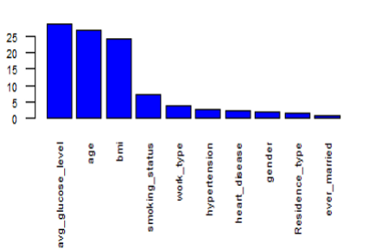
IMPORTANT VARIABLES
BAGGING
BOOSTING
Notes:
Boosting and bagging show similar important variables

Slide 12
BOOSTING WITH A LOWER PROBABILITY THRESHOLD
Variables | Precision | Recall
# of trees: 2000 ; shrinkage : 0.1 ; depth : 4 | 26% | 24%
# of trees: 2000 ; shrinkage : 0.1 ; depth : 10 | 25% | 16%
# of trees: 2000 ; shrinkage : 0.001 ; depth : 4 | 31% | 21%
# of trees: 2000 ; shrinkage : 0.001 ; depth : 10 | 33% | 32%
# of trees: 5000 ; shrinkage : 0.1 ; depth : 4 | 29% | 21%
# of trees: 5000 ; shrinkage : 0.1 ; depth : 10 | 23% | 13%
# of trees: 5000 ; shrinkage : 0.001 ; depth : 4 | 32% | 37%
# of trees: 5000 ; shrinkage : 0.001 ; depth : 10 | 33% | 42%
Test Set
 | Actual
Predicted | 0 | 1
0 | 706 | 23
1 | 29 | 9
Accuracy Measures
Accuracy | 93.22%
Precision | 23.68%
Recall | 28.13%
Probability threshold
If P(stroke | all variables) is greater than .2 then we predicted stroke, else no stroke.
Notes:
Changed boosting model with different probability thresholds, targeting recall while keeping precision as guardrail
Got 0.2 as optimal threshold, improving both precision and recall

Slide 13
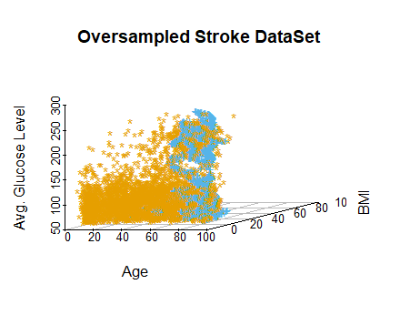
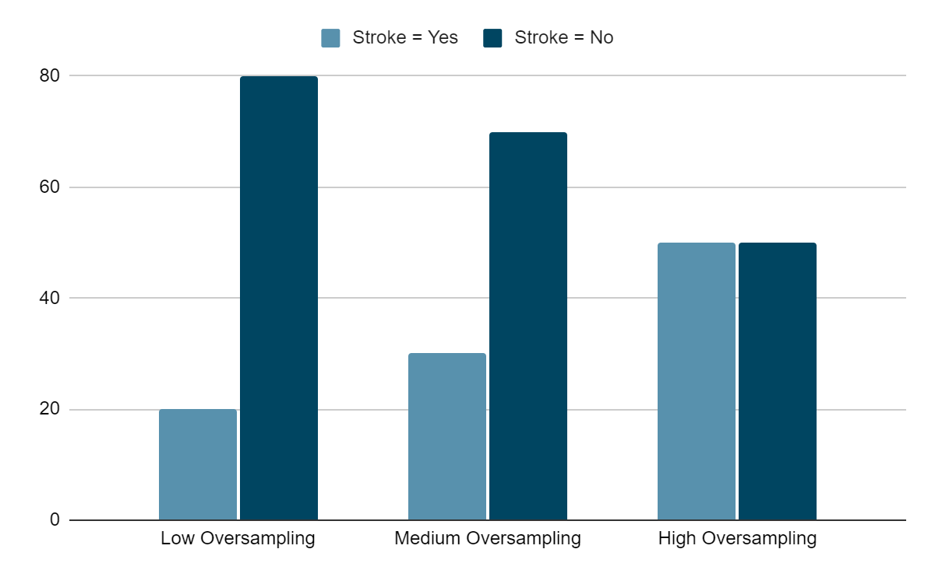
BAGGING WITH OVERSAMPLING
Low oversampling accuracy measures
Accuracy | 92.96%
Precision | 18.75%
Recall | 17.65%
Medium oversampling accuracy measures
Accuracy | 91.92%
Precision | 15.91%
Recall | 21.88%
High oversampling accuracy measures
Accuracy | 88.92%
Precision | 12.68%
Recall | 28.13%
Notes:
Also tried SMOTE oversampling to create synthetic response class labels
Tried different levels of oversampling and compared results on the test set
Higher the oversampling, more the recall but lower the precision ie. model classifying more and more patients as stroke
Fall back to Boosting model with 0.2 threshold as optimal model - 28% recall and 25% precision

Slide 14
03
CONCLUSION

Slide 15
DRAWBACKS
DATA LIMITATIONS
INCREASED VARIABLES
Only 249 ‘Yes’ Stroke values
Model could not learn & differentiate Class Balance was necessary
Other predictors of strokes: Medical History Alcohol Intake
Notes:
LARGER DATA SET
Increase accuracy of results
Increase ability to predict
and inform on strokes

Slide 16
CONCLUSIONS
01
02
03
The most important predictors for strokes are age, body mass index, and average glucose level
Our best model can predict 28% of strokes, with a 93.2% accuracy based off the data made available
A larger data set and more comprehensive variables could result in a more accurate model to predict strokes

Slide 17
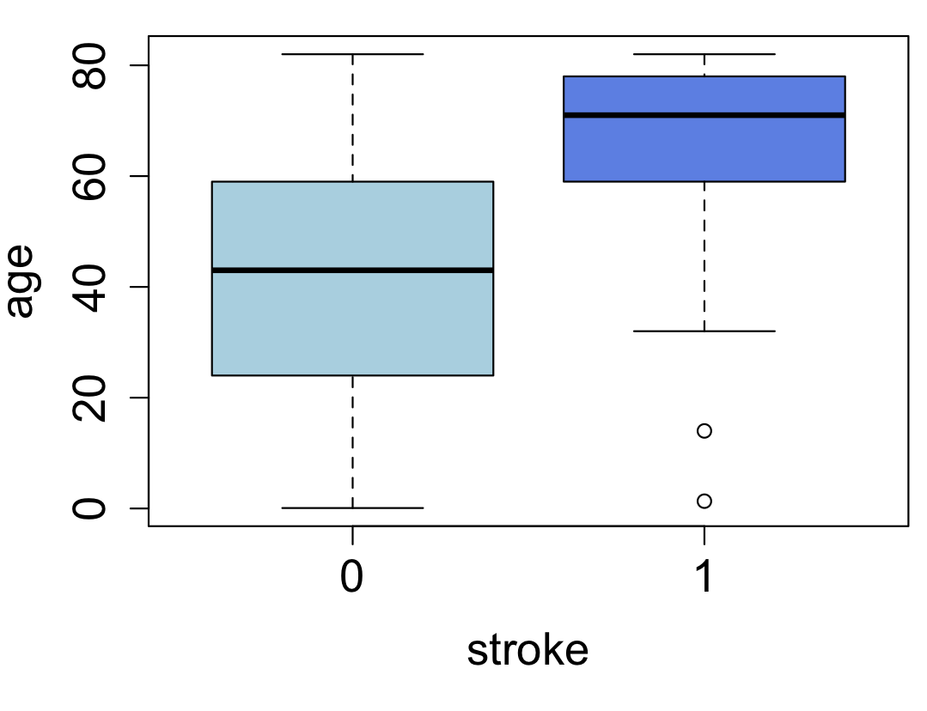
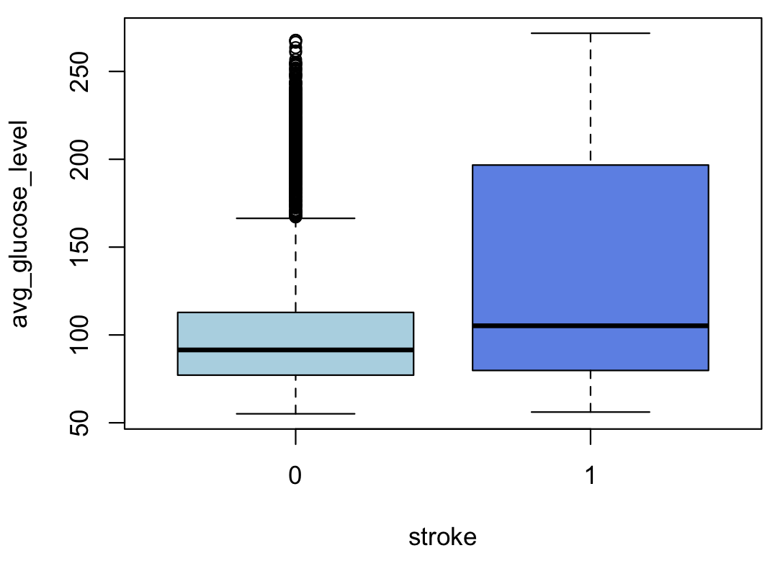
APPLICATION OF MODEL
FOR INDIVIDUALS OVER 60:
Keep glucose levels normal
Manage carb intake
Increase fiber intake
Focus on low glycemic foods
Drink plenty of water
Maintain a healthy and active lifestyle
Regular physical activity
Maintain a healthy weight
Yearly Physical
Notes:
Hospitals can use the model to alert patients if they are likely to experience a stroke and what they can to to lower their chances
Yearly physicals are a perfect opportunity to use the model
Hospitals or public health agencies can create pamphlets explaining what to do if you are experiencing a stroke and place them in areas where the people likely to have strokes according to the model would be
Examples:
Included with blood sugar monitors
Senior living homes
Caution of stroke if BMI over __ , age over ___ , glucose levels over ___ (daily sugar intake should be ___)

Slide 18
THANKS!
Any Questions?

Slide 19
APPENDIX

Slide 20
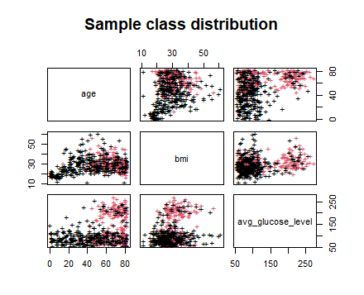
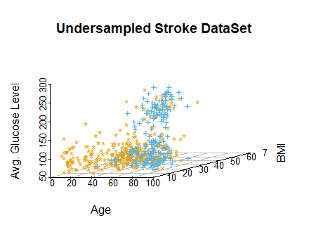
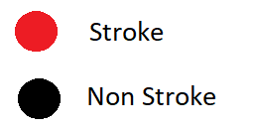
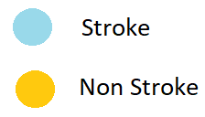
K Nearest Neighbour (Undersampling)
Notes:
Why SMOTE didn’t work on KNN - artificial negs created by considering KNN https://towardsdatascience.com/5-smote-techniques-for-oversampling-your-imbalance-data-b8155bdbe2b5

Slide 21
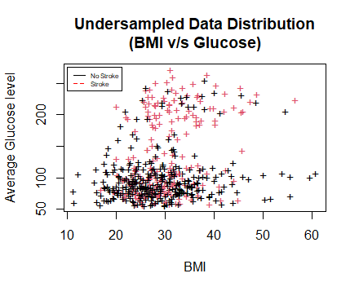
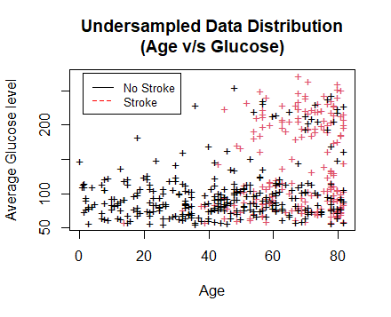
Exploratory Data Analysis (Undersampled)

Slide 22
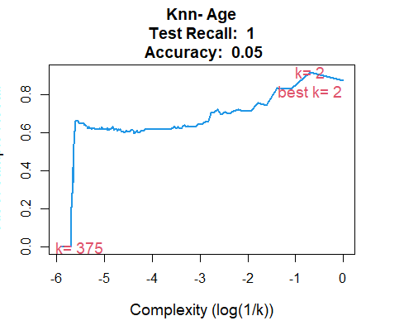
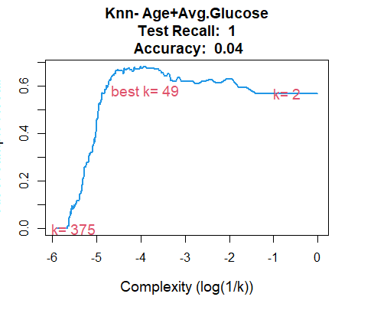
K Nearest Neighbour (Undersampling)

Slide 23
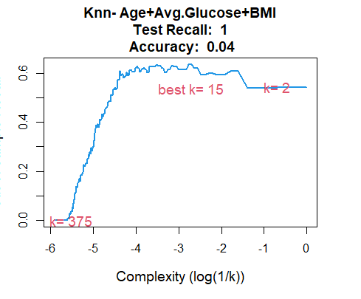
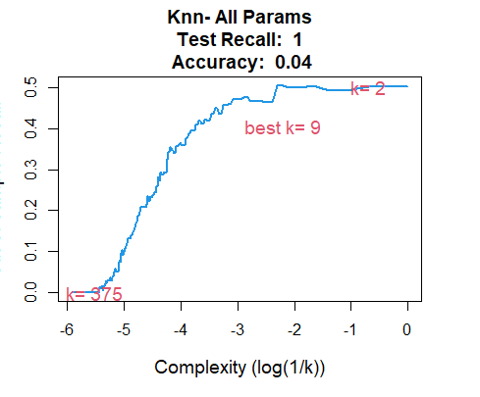
K Nearest Neighbour (Undersampling)
Notes:
Ran several Knn models with different parameters.
K-Fold Cross Validation results:

Slide 24
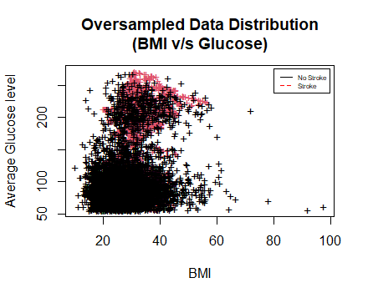
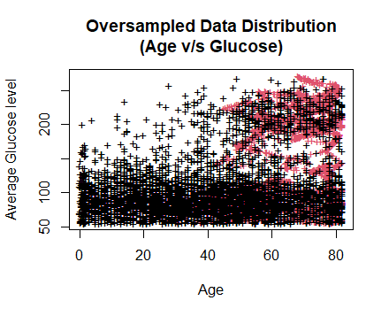
Exploratory Data Analysis (Oversampled - SMOTE)

